Slide 1


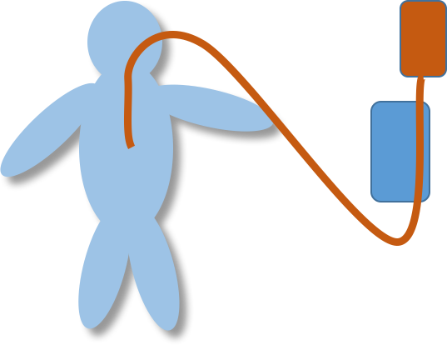

Slide 2
CLINICAL NUTRITION
ARTIFICIAL FEEDING MODE
Main uses : ICU, Oncology, ORL, GI Chirurgy, Neurology, Homecare
ENTERAL FEEDING
PARENTERAL FEEDING
Nutrition Solution
Parenteral Solution
Parenteral Feeding Pump
Feeding Pump
Tubings
Tubings
FIRST INTENTION

Slide 3
PRESCRIPTION 1000 Units (Calories, proteins …)
COMPLIANCE only 600 Units
Induced Morbidity
Increase Death rate
Increase Admission Rate
Increase LOS
Increase Length of recovery
!

Slide 4

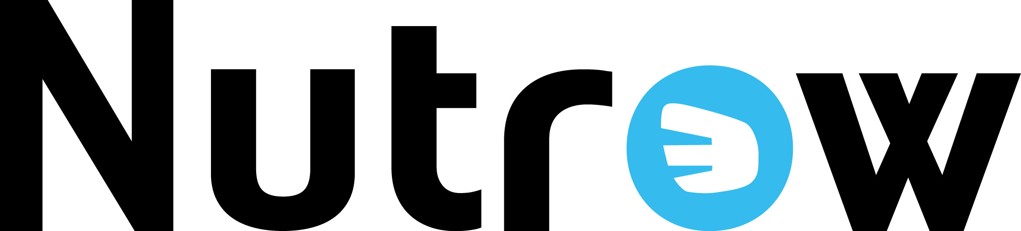
PART OF THE SOLUTION

Slide 5
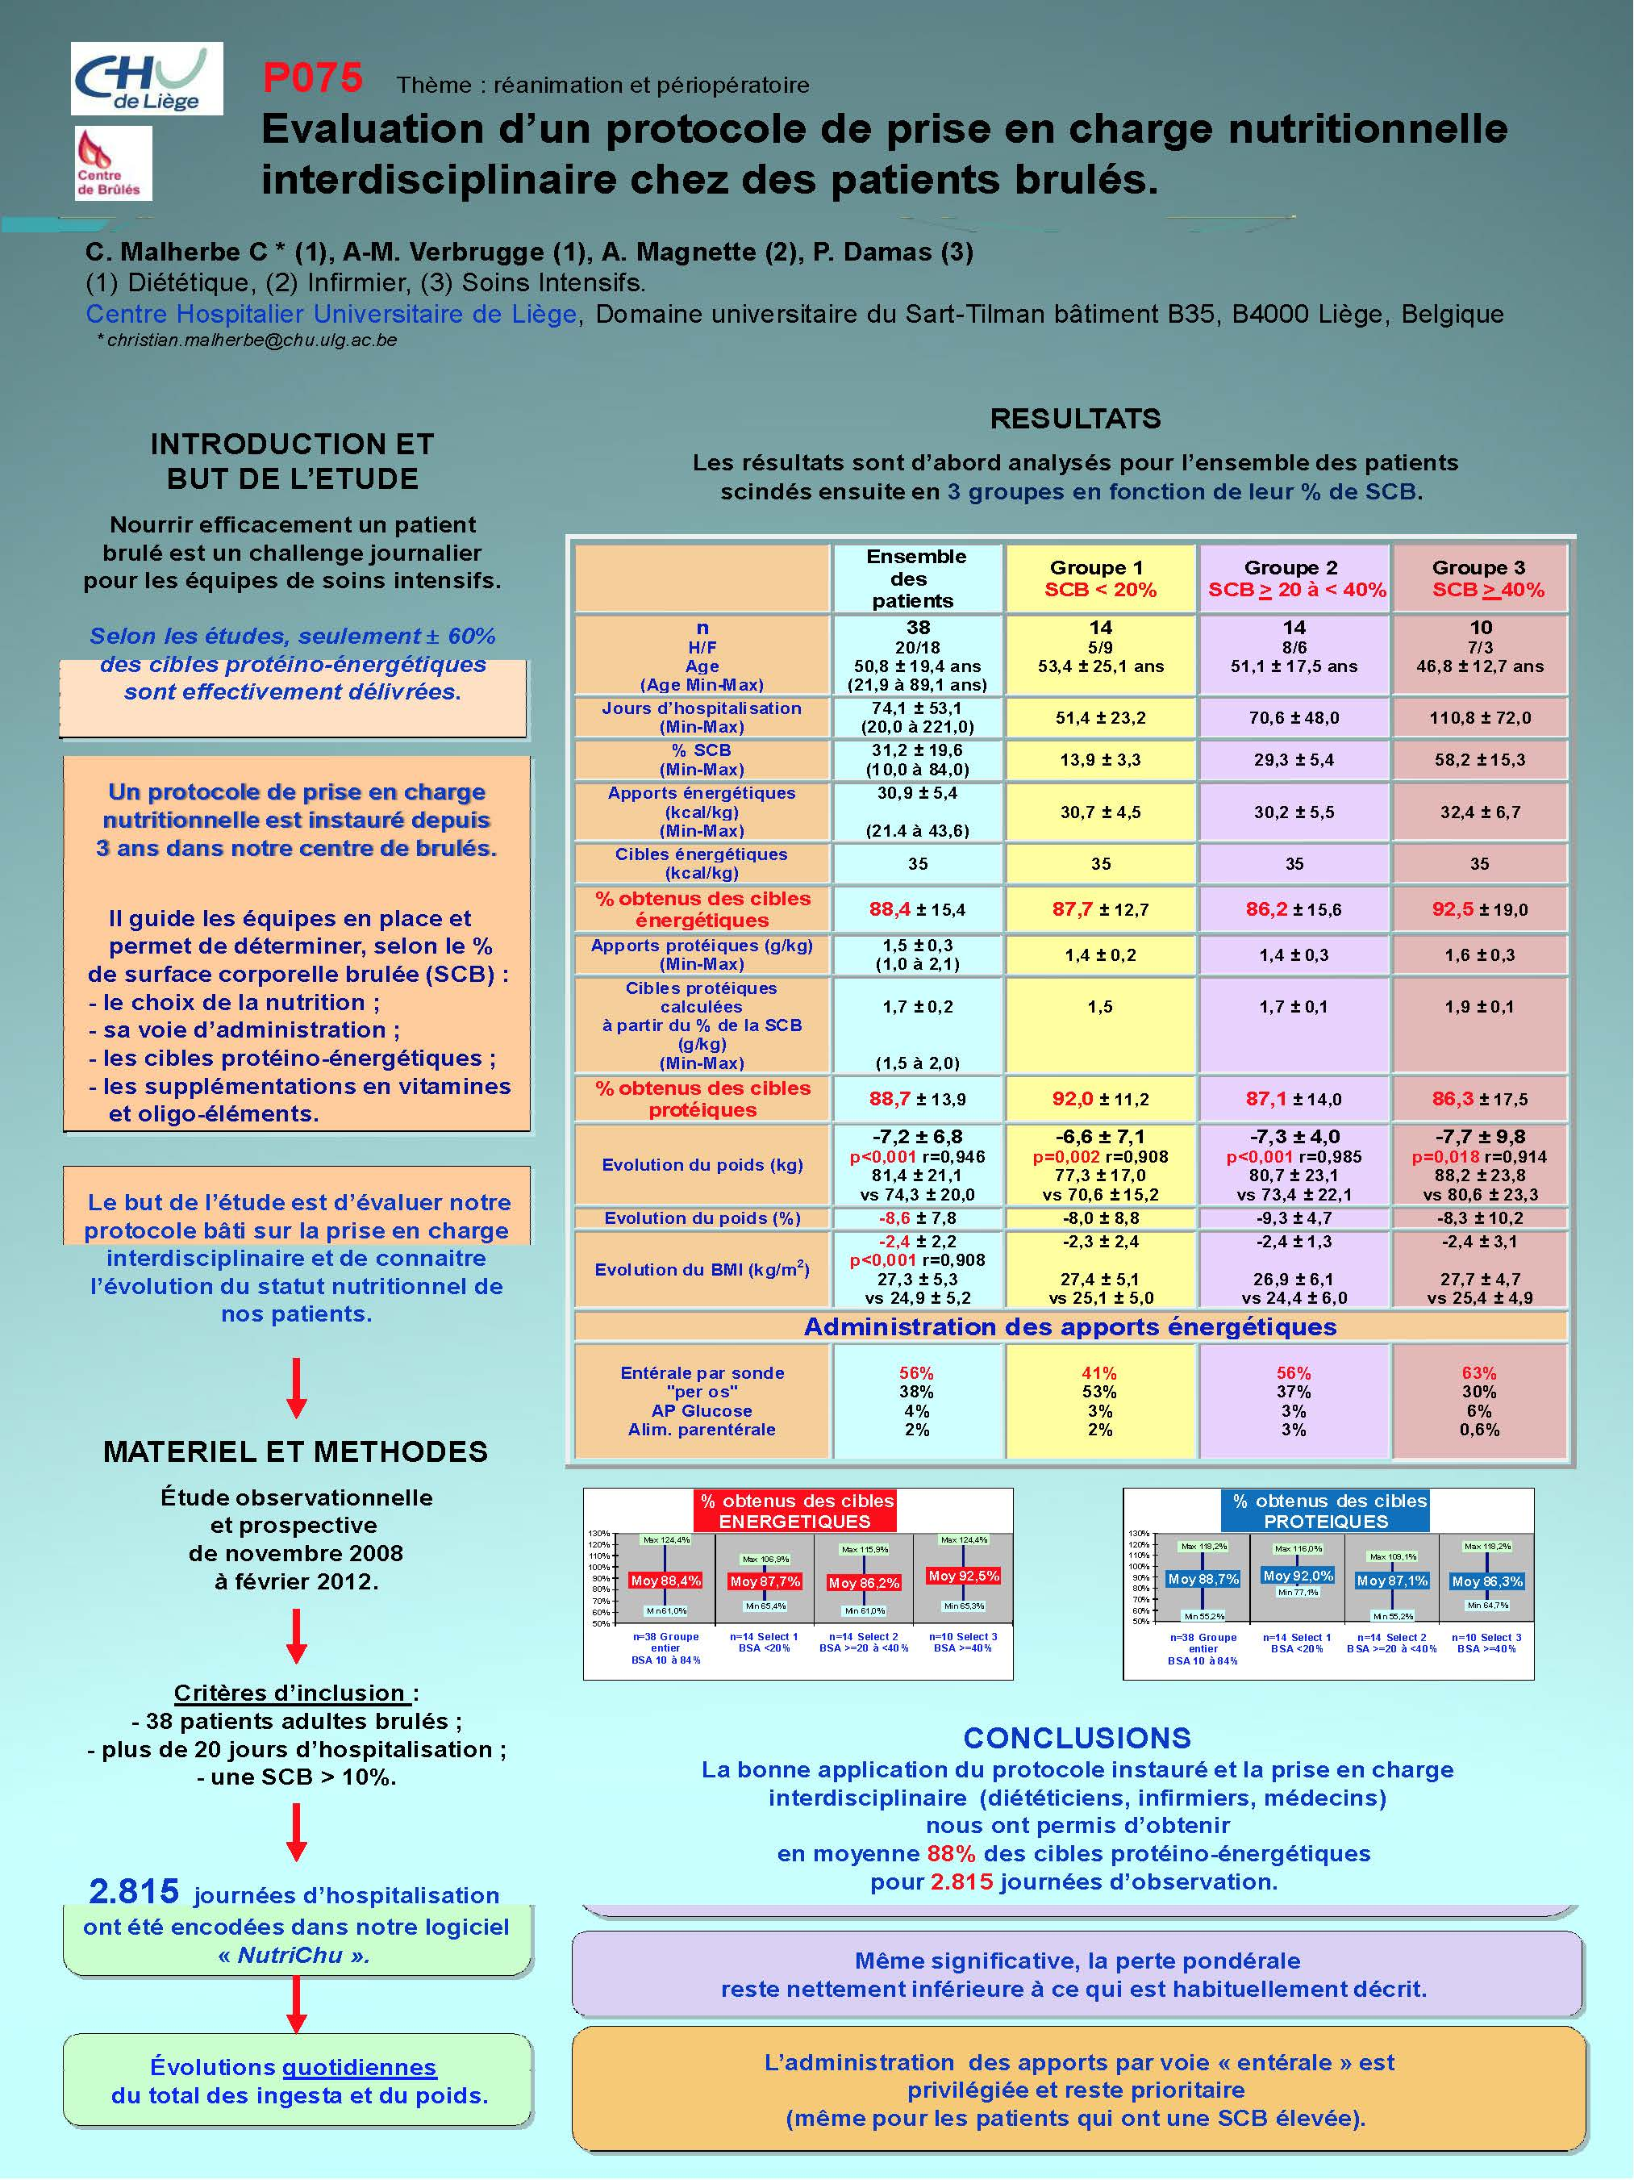
NUTROW INCREASES COMPLIANCE OF CLINICAL NUTRITION
In Intensive Care , too many patients caring and daily events, limit respect of prescription.
Using DIM3’s Platform Nutrow, compliance prescription increases from 60 to to 88% .
Poster: Evaluation d’un protocole de prise en charge nutritionnelle interdisicplinaire chez les patients brules / D. Malherbe & all

Slide 6
NUTROW USES PUMPS DATA
MORE THAN 97% OF ENCODING IS MANUAL
Encoding Mistakes
Procedure for Nurses
Time and cost consuming
Not perceived need for All Doctors
!

Slide 7
CLINICAL NUTRITION
ARTIFICIAL FEEDING MODE
Theoretical Connectivity
ENTERAL FEEDING
HOSPITAL SERVER
WARD SERVER
WIRED CONNECTION
Nutrition Solution
Expensive
Laborious
Timeline
Not perceived need
Feeding Pump
SCREENS
CLINICAL SOFTWARE NUTROW
CENTRAL ALARM
Tubings
FIRST INTENTION
NOT ONLY FOR FEEDING PUMP

Slide 8
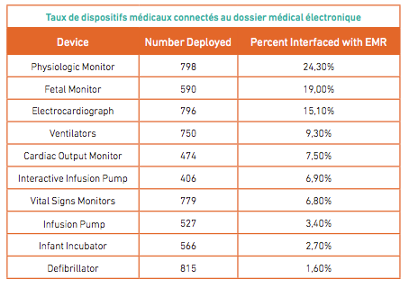
RATIO CONNECTED MEDICAL DEVICES TO EHR (EUROPEAN STUDY)
No Feeding pump in the study

Slide 9
PART OF THE SOLUTION
+
Patent Pending

Slide 10
CLINICAL NUTRITION
ARTIFICIAL FEEDING MODE
Theoretical Connectivity
HOSPITAL SERVER
WARD SERVER
HUB

Slide 11
FEEDING PUMP OR MD
USING SDK/API FURNISHED BY MD PRODUCER
CAPTURE RAW DATA
DATA ENCRYPTED
DATA BUFFERED
OTHER FEATURES
SPECIFIC CONNECTOR
FEEDIM
DATA SENT REGULARLY TO NUTROW PC OR DIM3 HUB
NUTROW INTEGRATES DASHBOARD OF PUMPS FOR
ALARM MONITORING
AND
MAINTENANCE SOFTWARE ALGORITHMS
AVAILABLE : Fresenius APPLIX, Nutricia

Slide 12
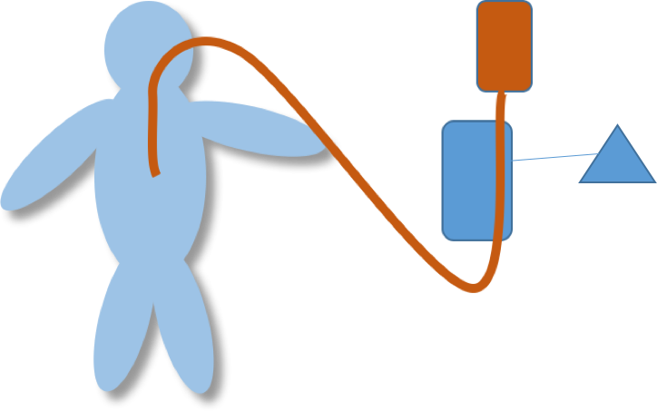
THANK YOU

